Slide 1

My Hair Done
Style or get styled
Lucas da Silva – x17118361
BSc honours in Computing – Software Development Final presentation

Slide 2
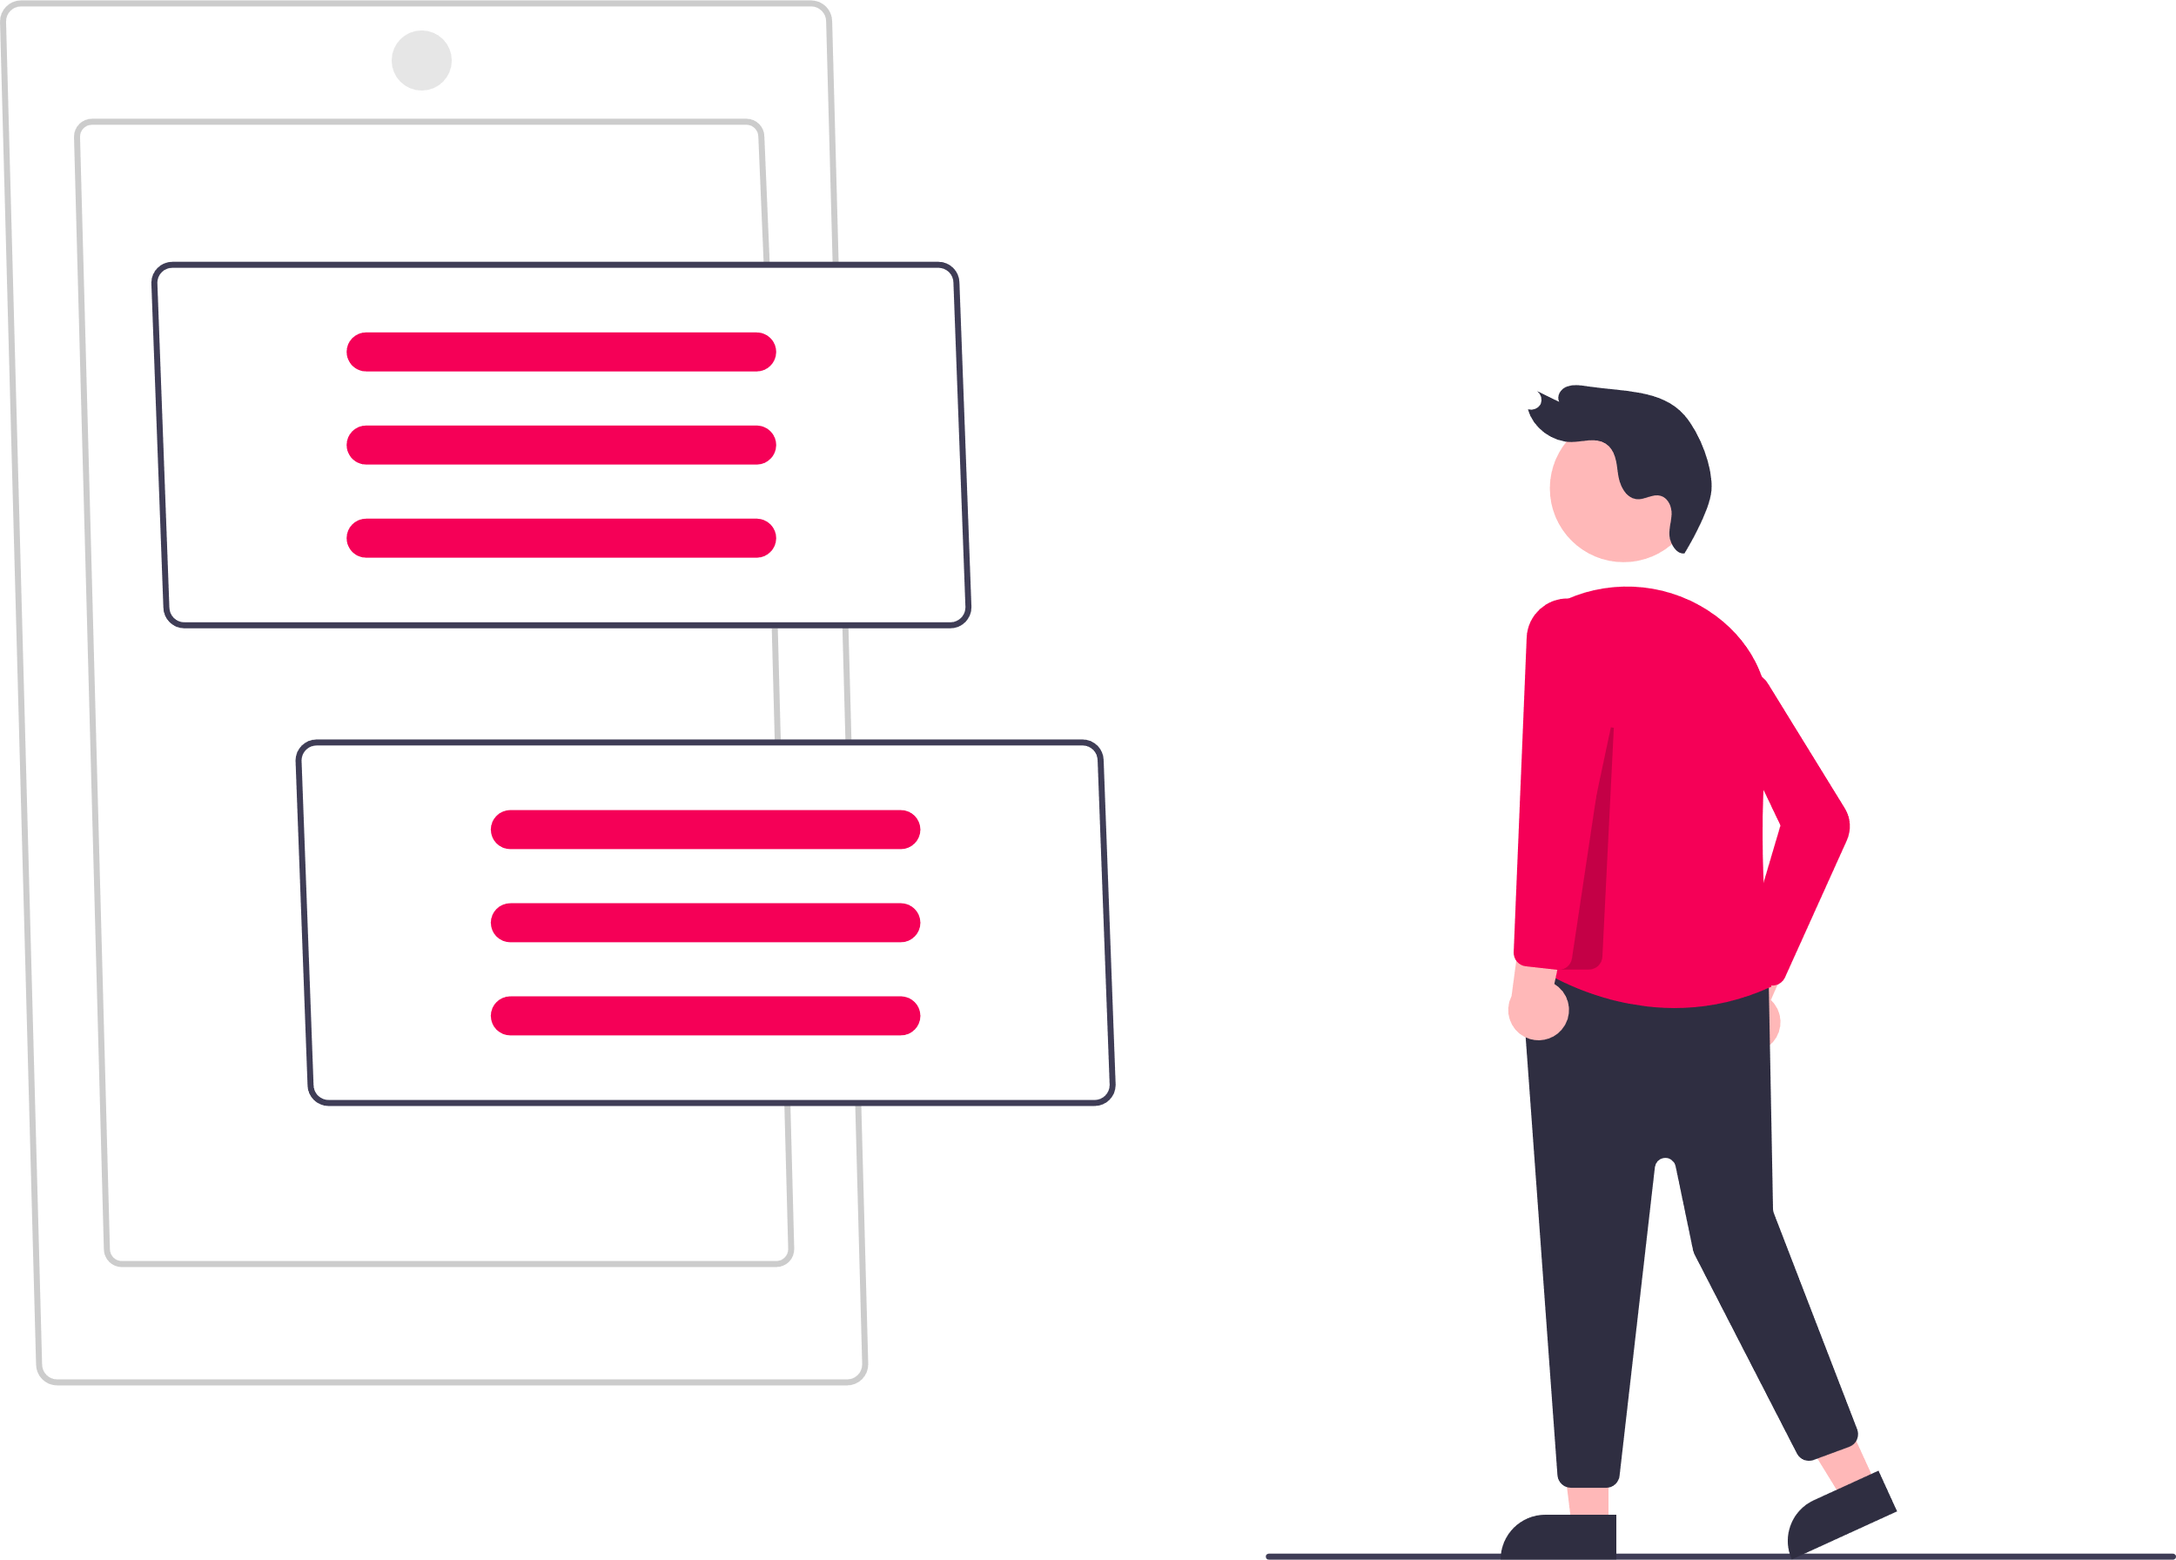
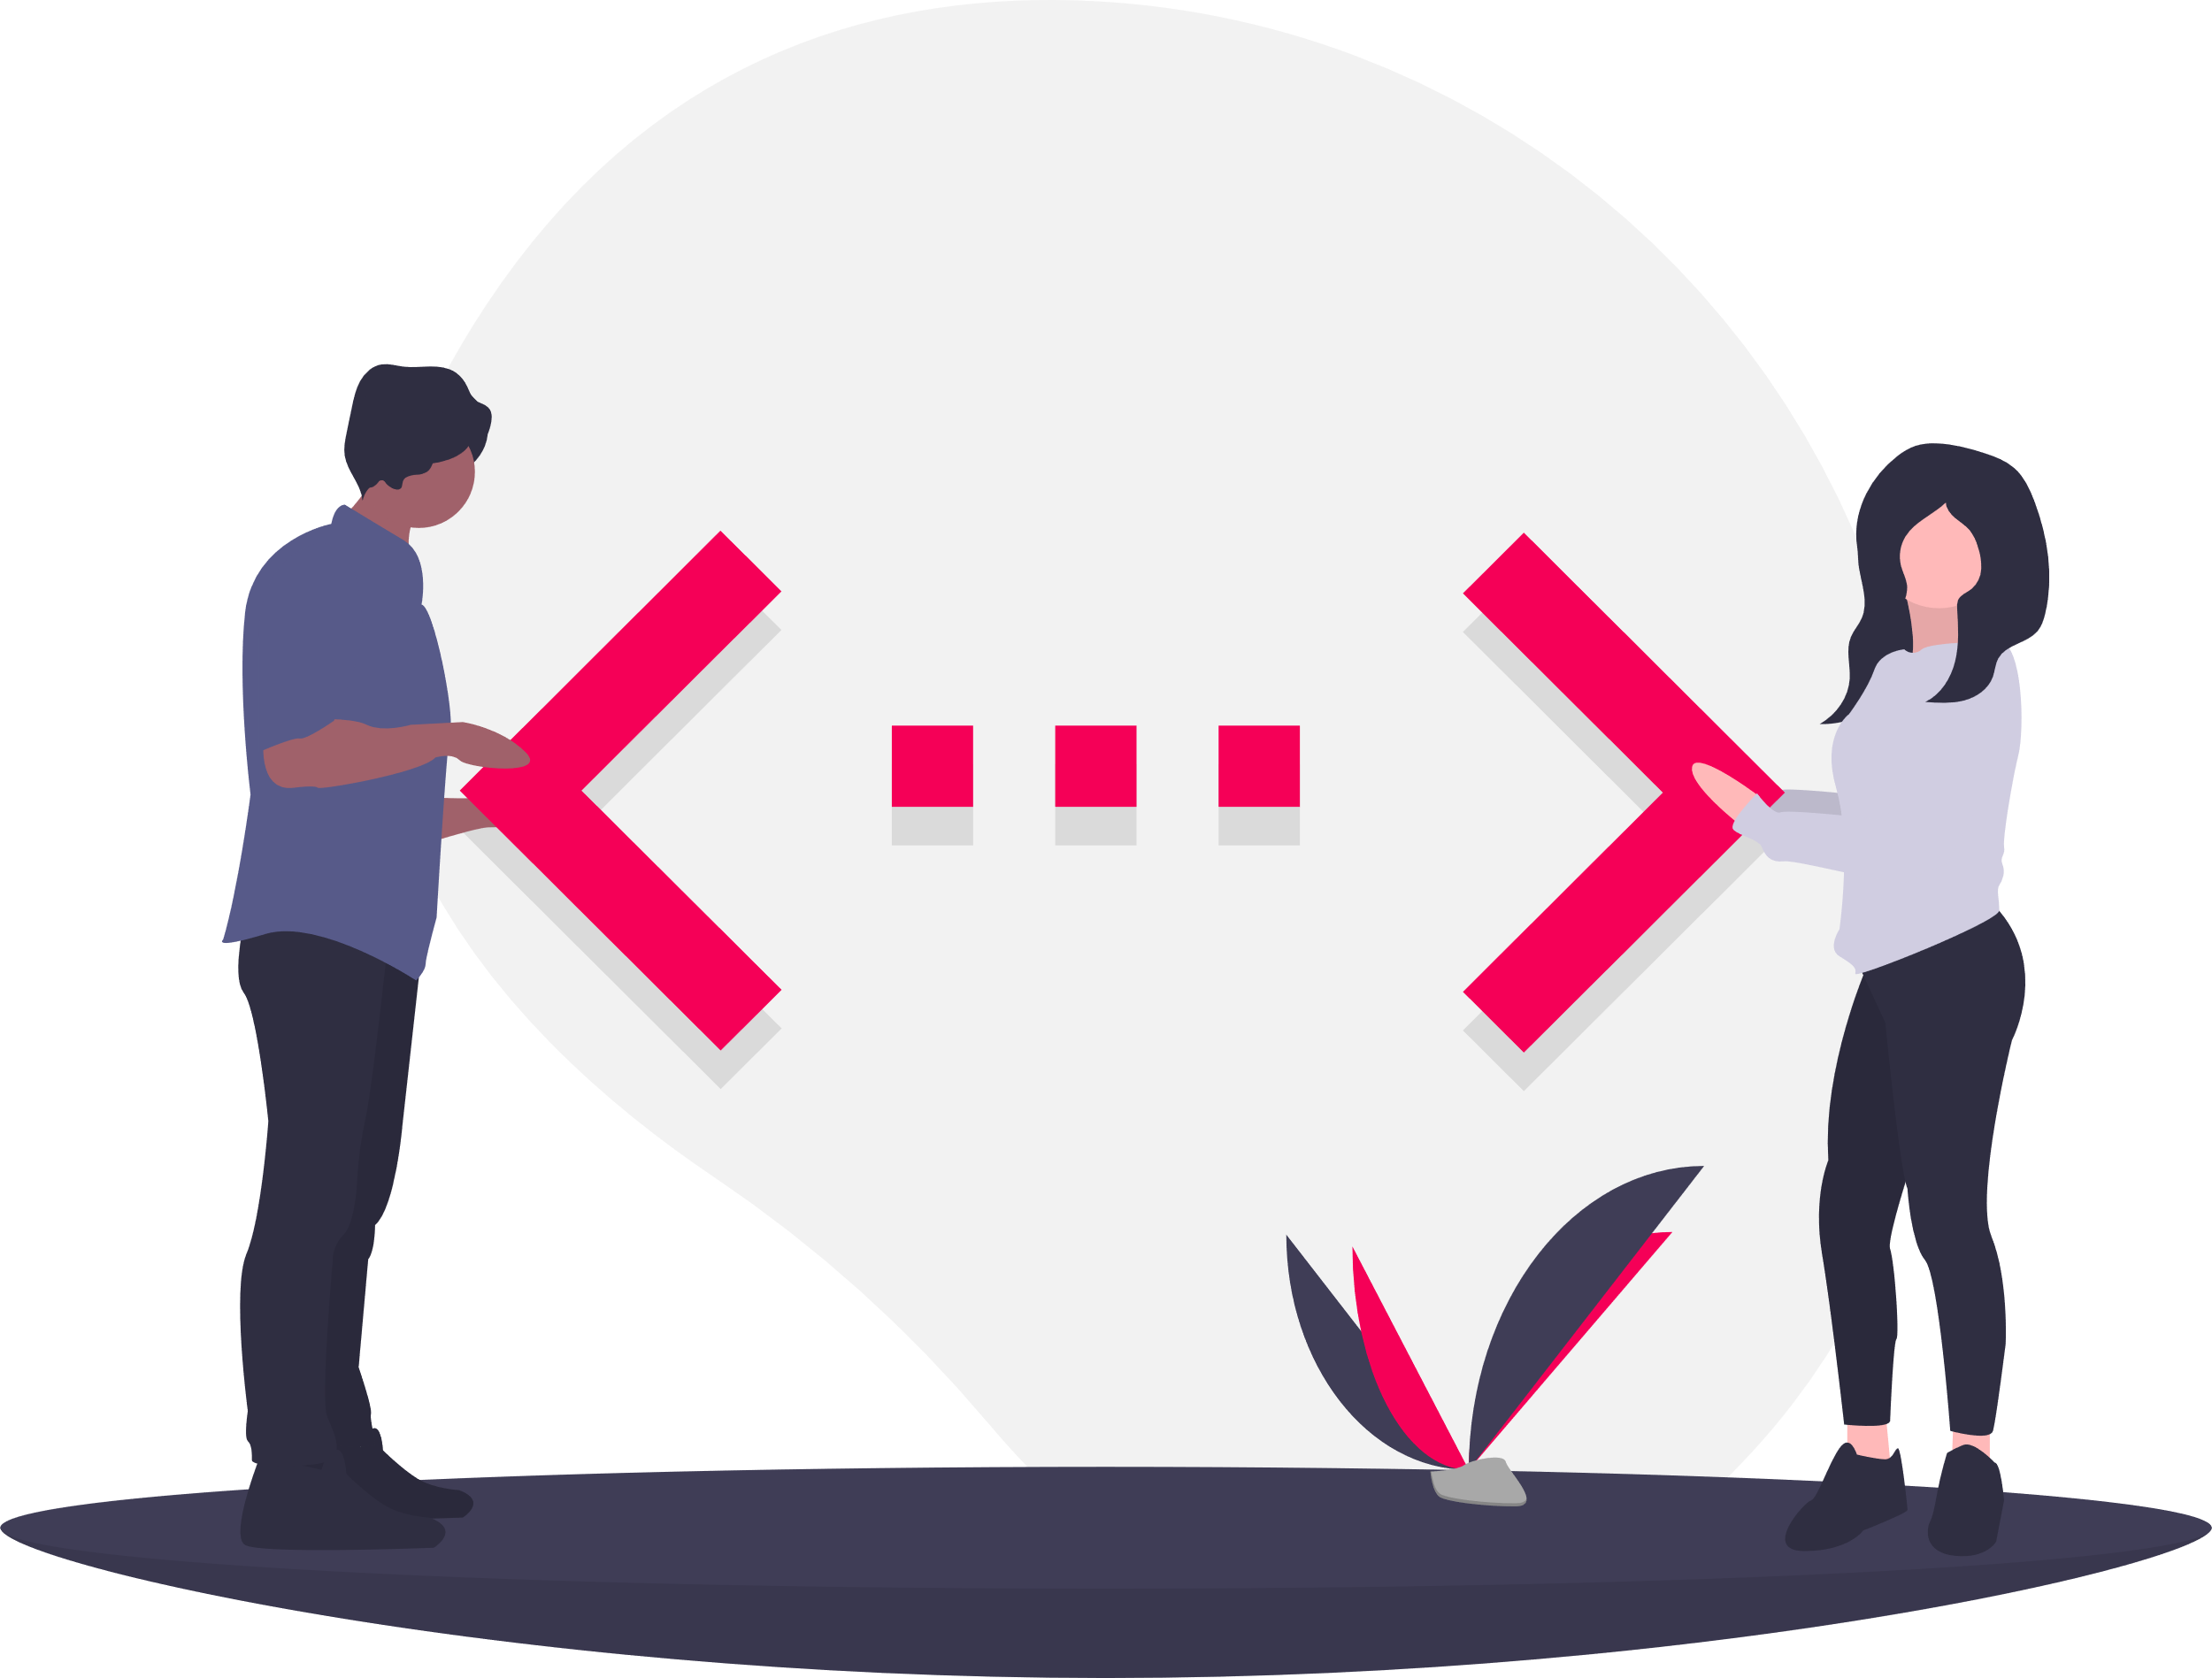
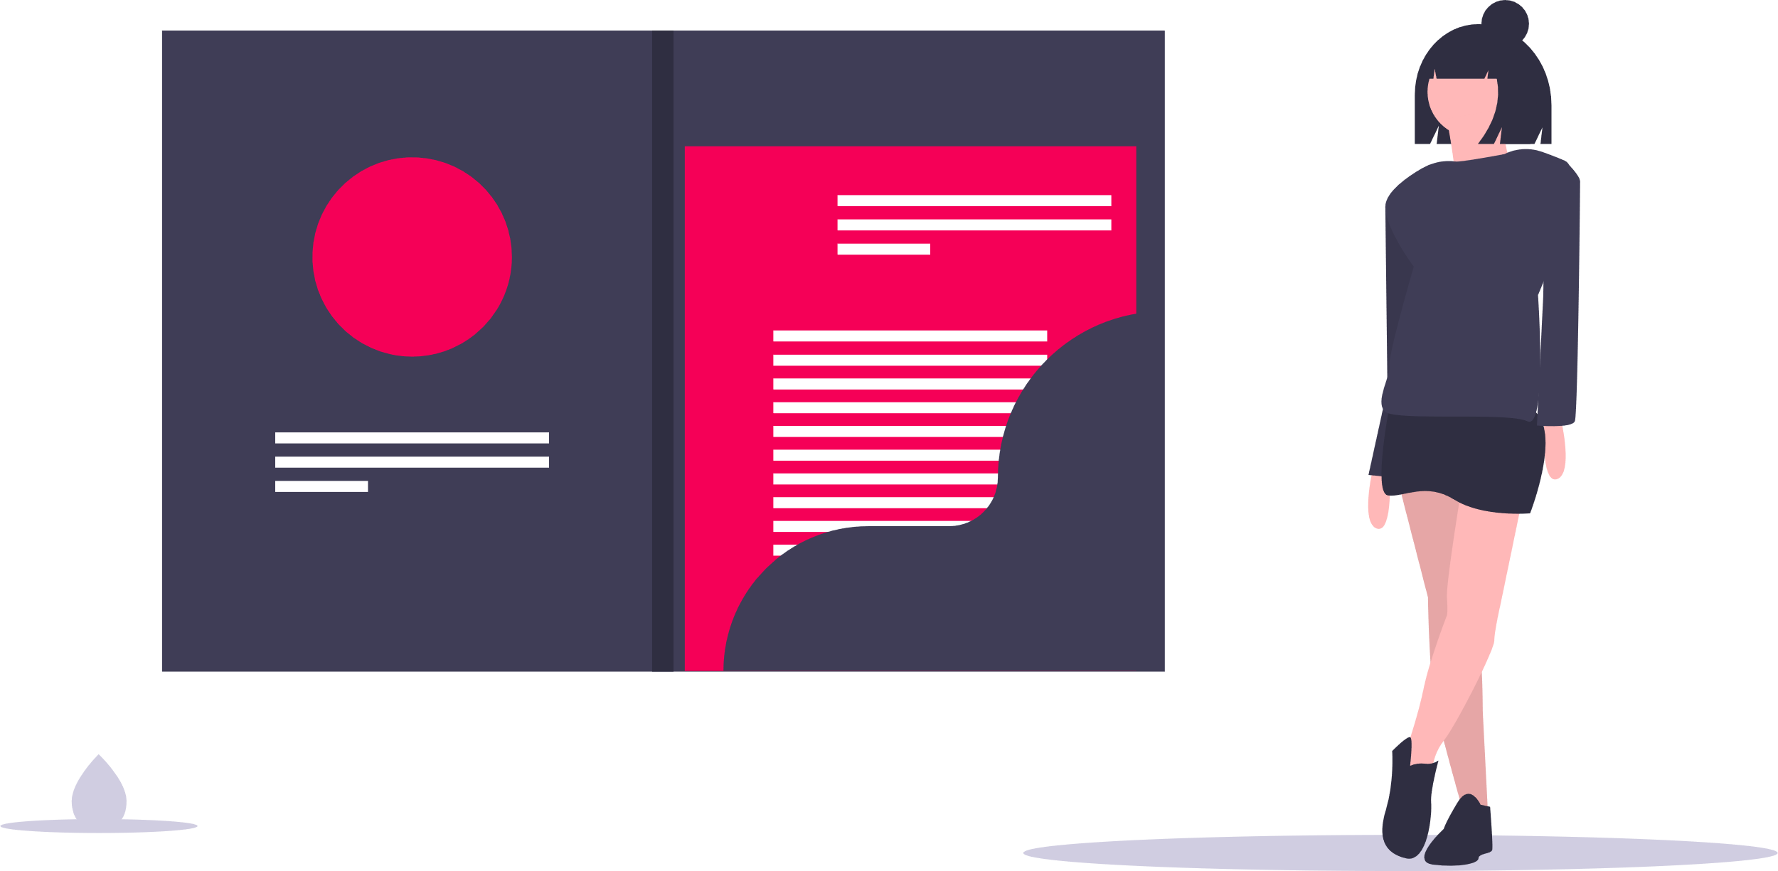
What is “My Hair Done”? What does it do?
Web Application: https://myhairdone.co.uk
Hairdressers
Customers
Customers & Hairdressers
A single application to search for hairdressers of any style or location
Offer a dedicated platform for Independent Hairdressers to publish their portfolio and contact details
Hairdressers and customers can manage their bookings right in the platform, no more need for phone calls.
AR tool for customer to try popular haircuts using their own device camera

Slide 3


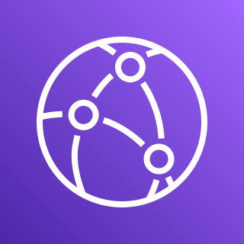













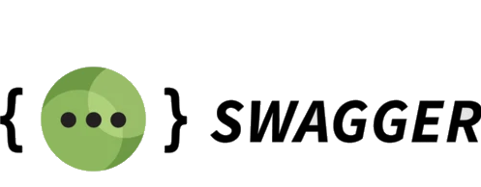



Technology Stack
Infrastructure
AWS S3
AWS Simple Email Service
AWS Simple Queue Service
AWS Route 53
AWS EC2
AWS CloudFront
AWS Secrets Manager
AWS Certificate Manager
AWS RDS
DevOps
AWS CodeDeploy
AWS CodePipeline
Backend
AWS Lambda
Frontend Web

Slide 4
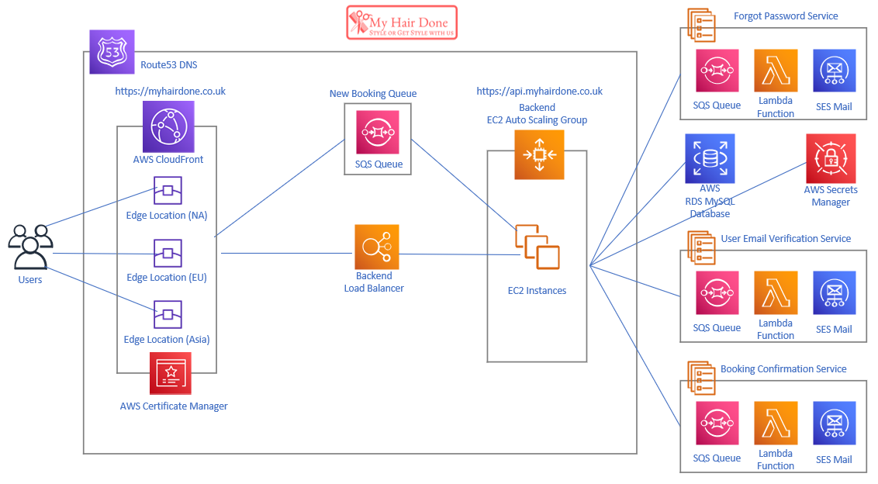
Implementation Architecture

Slide 5
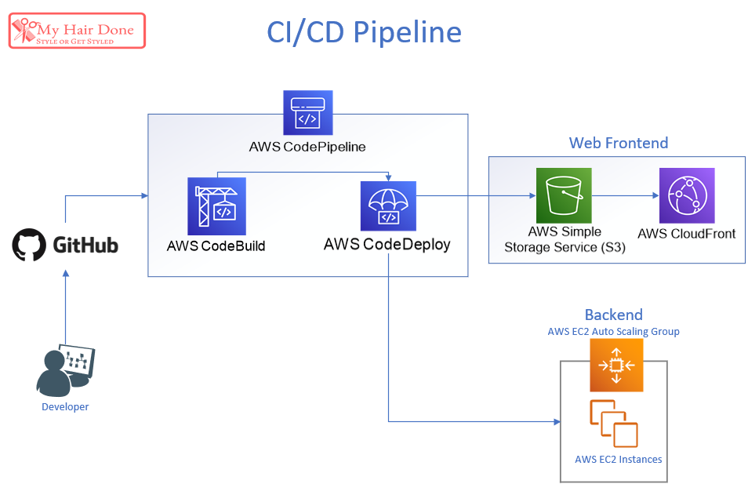
Implementation DevOps

Slide 6

Demonstration
https://api.myhairdone.co.uk
https://myhairdone.co.uk
https://github.com/lucasfdsilva/my-hair-done

Slide 7
Q & A
1. Discuss the most difficult aspect of your project with particular emphasis on those areas related to your chosen specialization
2. Discuss the most innovative aspect of your project. For example, with respect to your use of technologies, programming languages, frameworks or security protocols etc.
3. With respect to your requirement specification, what requirements have you since added, removed or changed and what impact has this had on the completeness of your project?
4. Describe in detail, your approach to Testing
5. If you were to start your project again would you change any of the decisions you made? For example, in relation to tools, technologies, languages, algorithms, security, testing strategies etc.

Slide 8

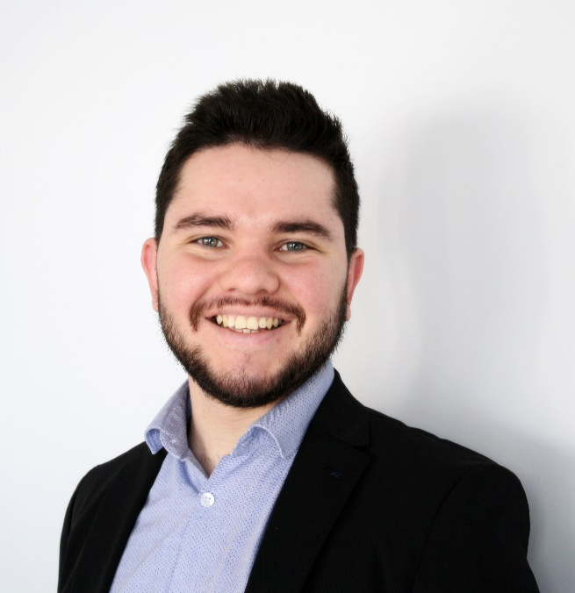
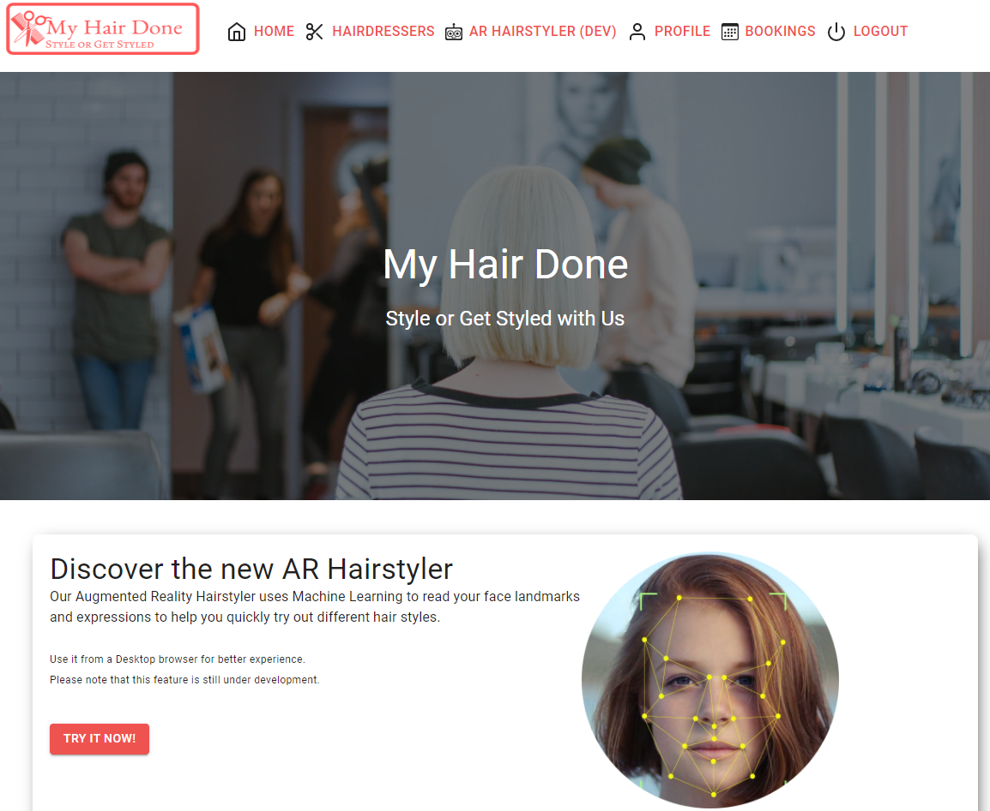
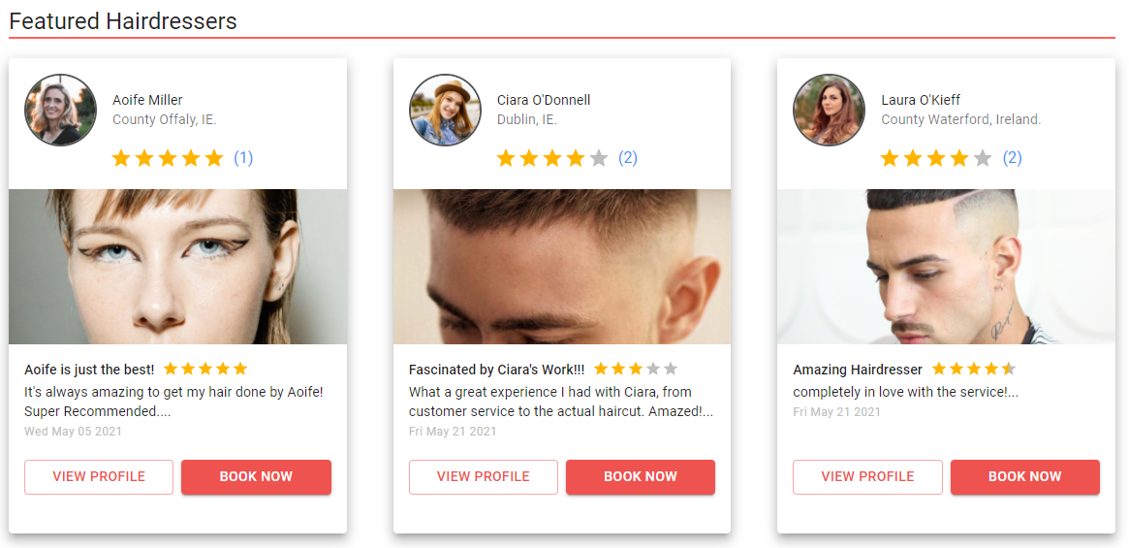

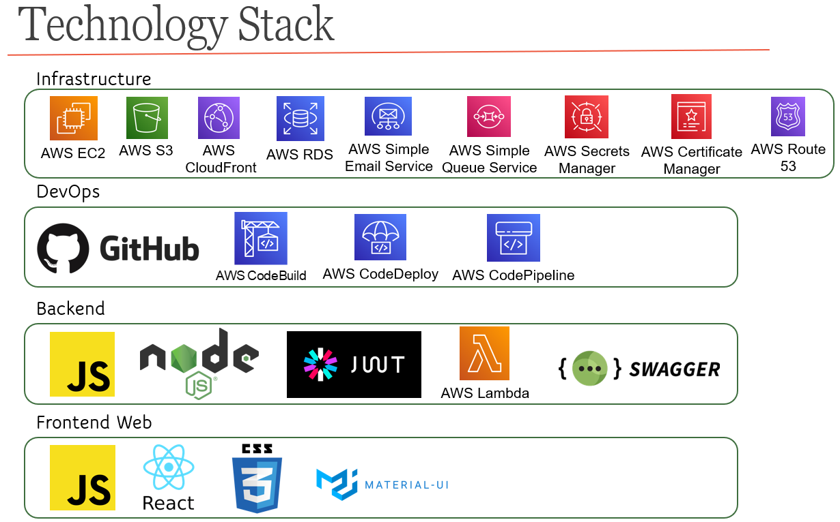

Lucas da Silva BSC Honours in Computing – Software Development
My Hair Done
My Hair Done is a Web application that aims to streamline the process of getting a haircut for both independent professionals and customers.
For Professionals, the application is a platform to manage their bookings and availability and to publish their portfolio and style characteristics so that customers looking for a professional specialised in a given style or location can find a match easily.
For customers, the app helps them on 3 different fronts: 1st The AI Hairstyle builder helps users to try different haircut styles & 2nd, the app helps them find professionals that match their hairstyle choice and finally, schedule appointments with any professional in the platform through the app.

Slide 9
Thank you
Lucas da Silva – x17118361
BSc honours in Computing – Software Development Final presentation

